Slide 1
  Friend functions

Slide 2
Friend Functions
friends allow functions access to private data of other classes.

Slide 3
Friend Functions/Classes
Friend functions
A 'friend' function has access to all 'private' members of the class for which it is a 'friend'.
To declare a 'friend' function, include its prototype within the class, preceding it with the C++ keyword 'friend'.

Slide 4
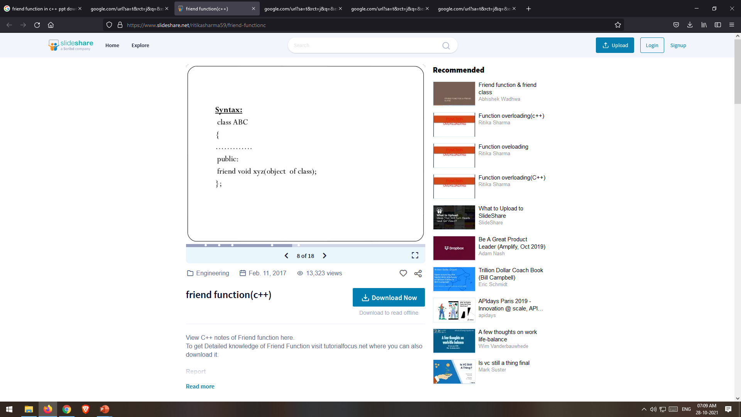
Friend Functions/Classes

Slide 5
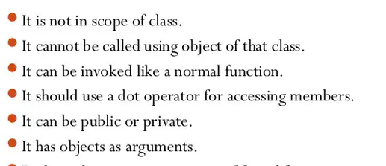
Charactertistics of Friend Functions

Slide 6


Friend Functions Example

Slide 7
Thank You

